Slide 1

Hello students of Trepalio!
My name is
Matthew!
I am excited be your new language assistant this year!

Slide 2
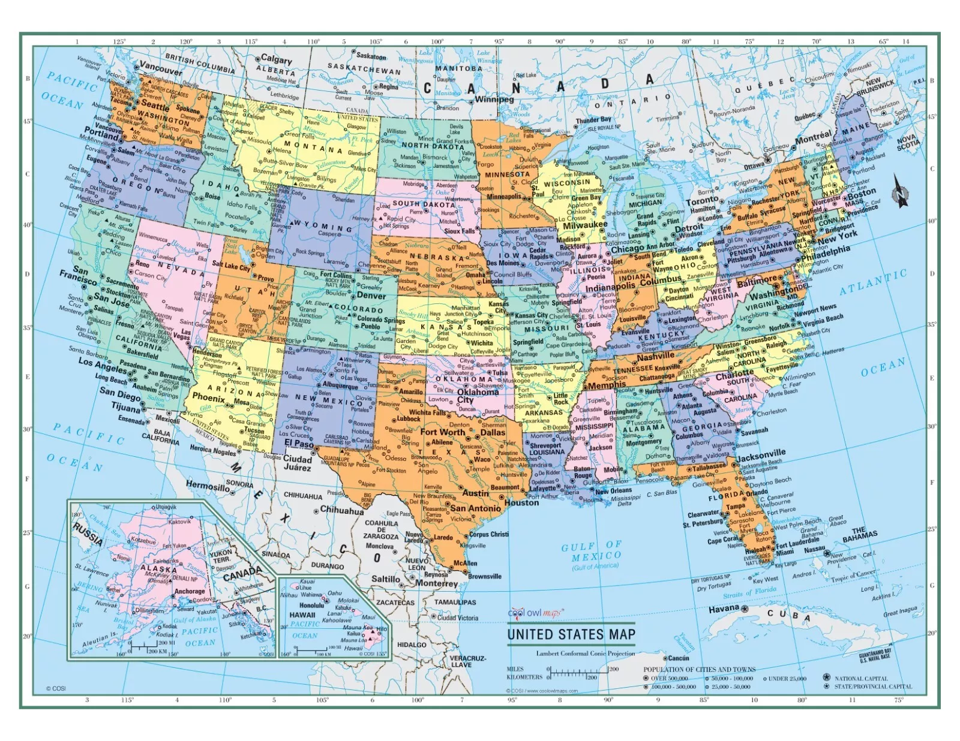

Where am I from in the USA?
The Empire State of New York!
It is just one of fifty other states in the United States.

Slide 3



Where am I from in New York?
I was born and raised in the City of New York!
Also called by its nickname Gotham

Slide 4

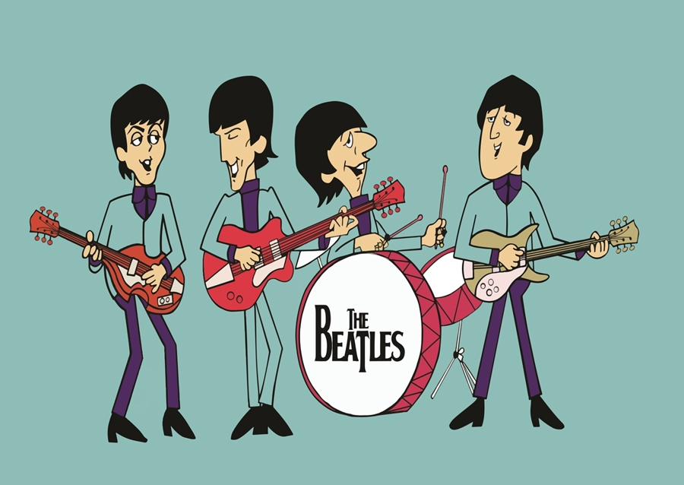
What music do I enjoy?
I enjoy listening to music, but I grew up mostly listening rock music from the United Kindom.
Some bands I enjoy:
The Beatles
Led Zeppelin
The Who
Pink Floyd
My mother's favorite band!

Slide 5
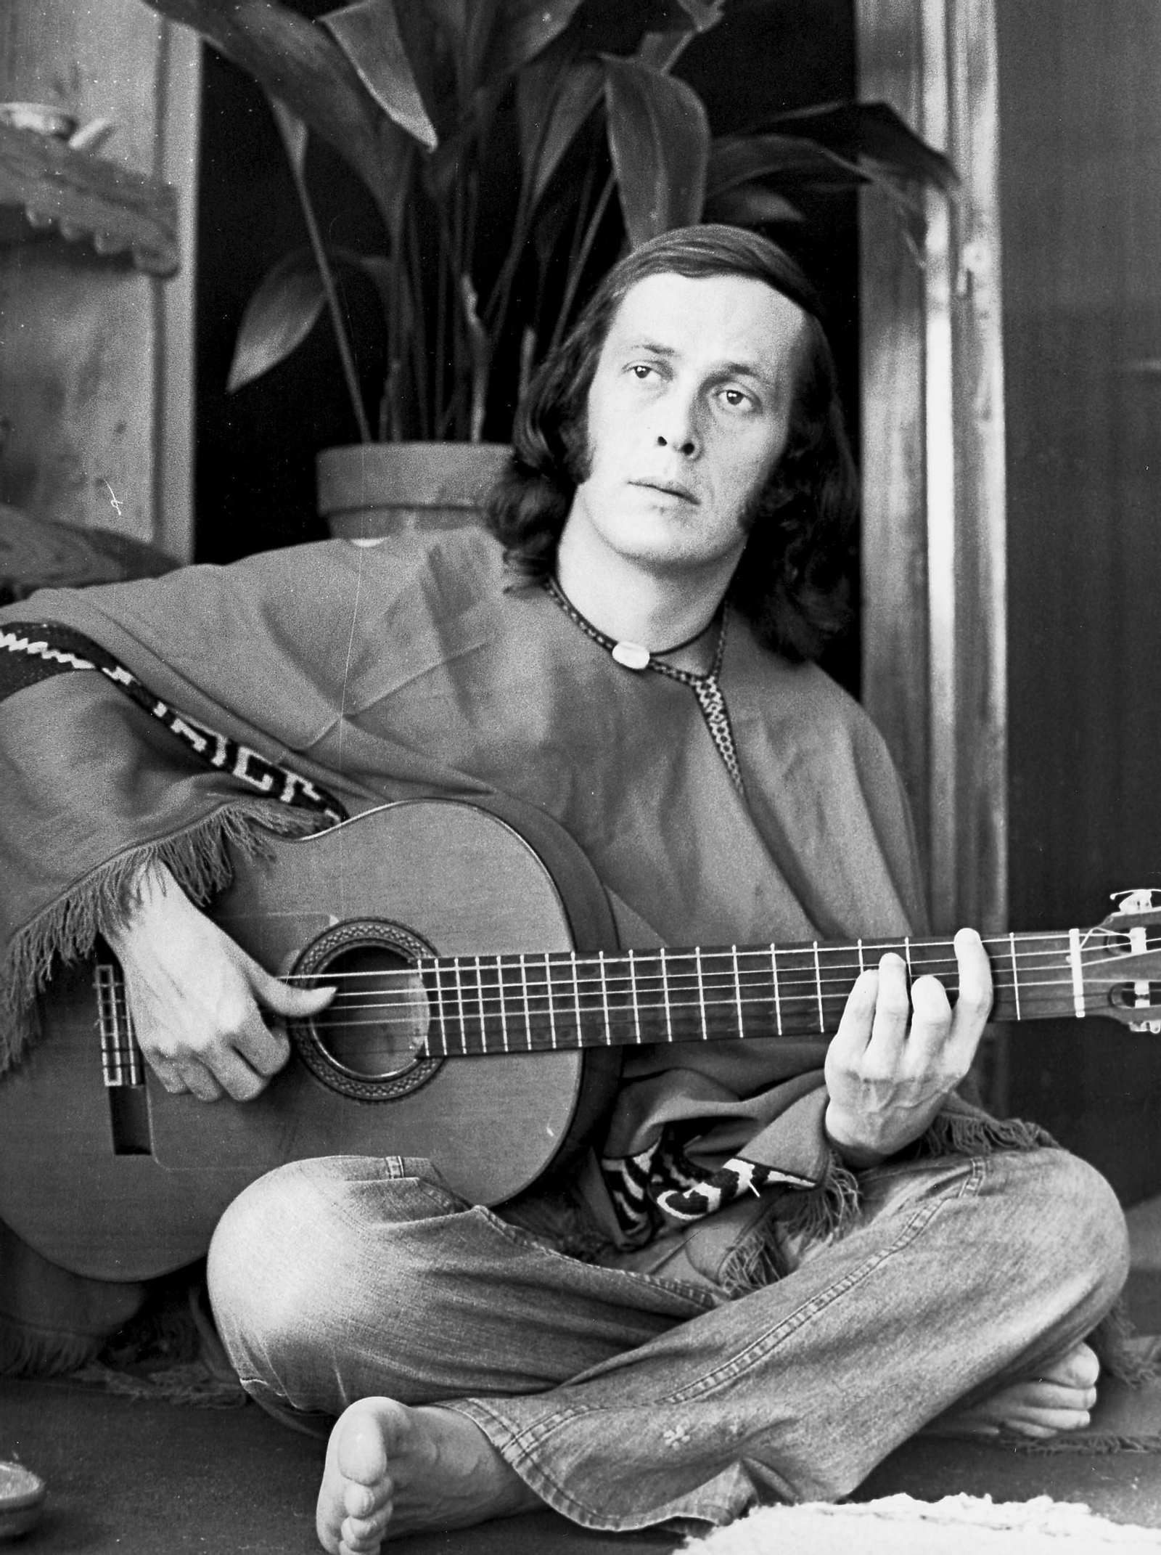
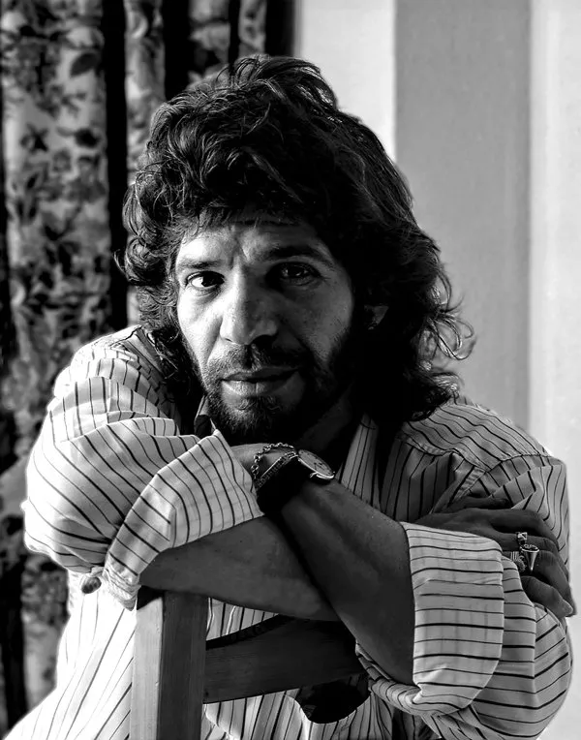
Do I enjoy Spanish music?
Yes! I also enjoy music from Spain especially flamenco guitarist Paco de Lucía and singer Camarón de la Isla!
Some music in Spanish I also enjoy:
Aventura
Julio Iglesias
Enrique Iglesias

Slide 6



What are some of my hobbies?
I enjoy reading about history from all over the world, but I really enjoy reading about the history of ancient Rome!
I enjoy learning some Latin too!

Slide 7



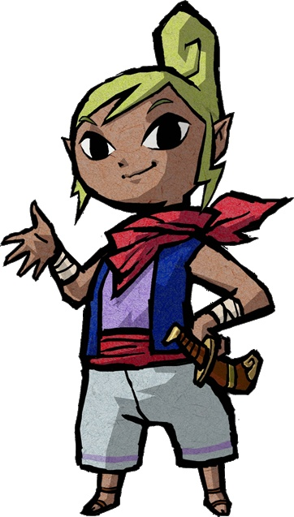

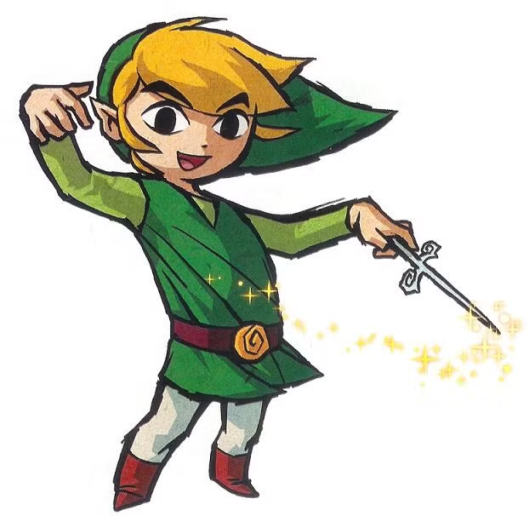
What are some of my hobbies?
I also enjoy playing videogames!
I love games by Nintendo too!

Slide 8
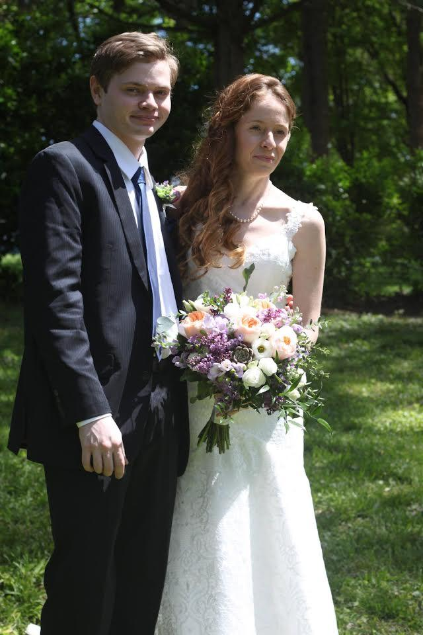
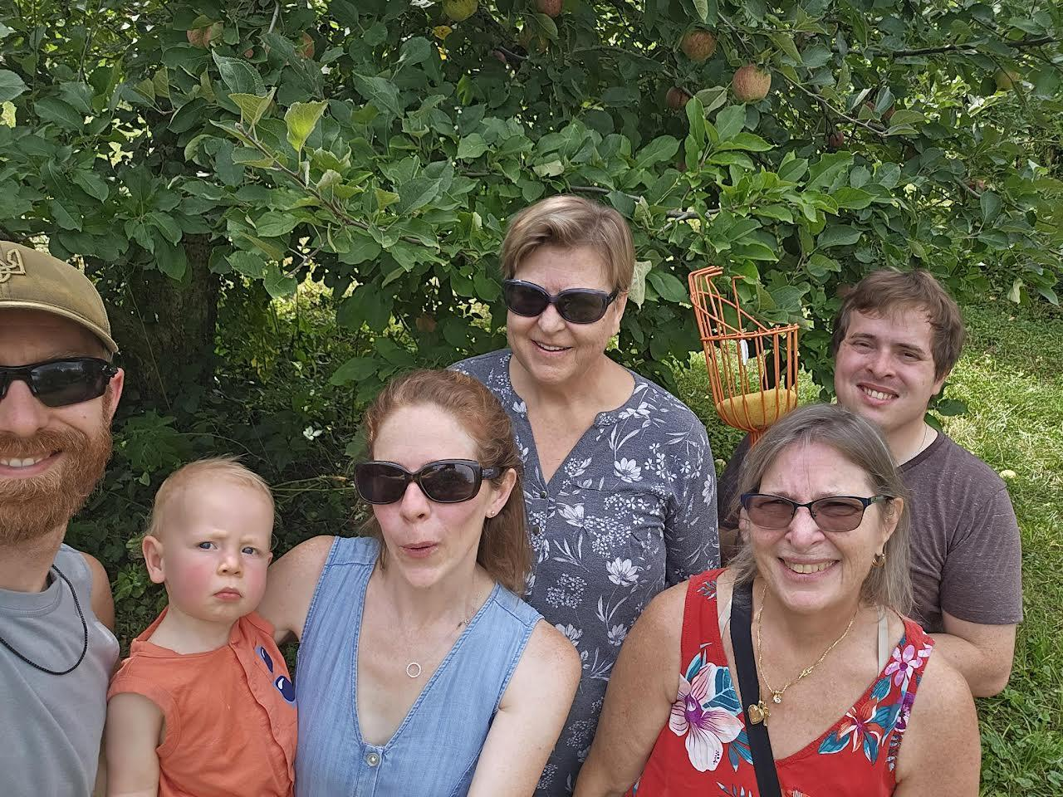
Here is my family!

Slide 9
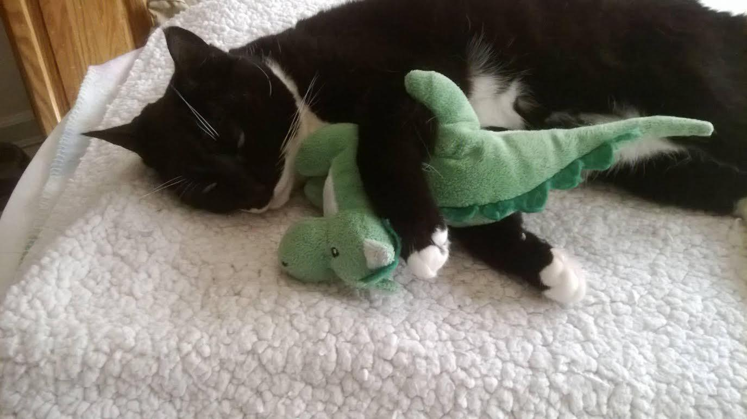
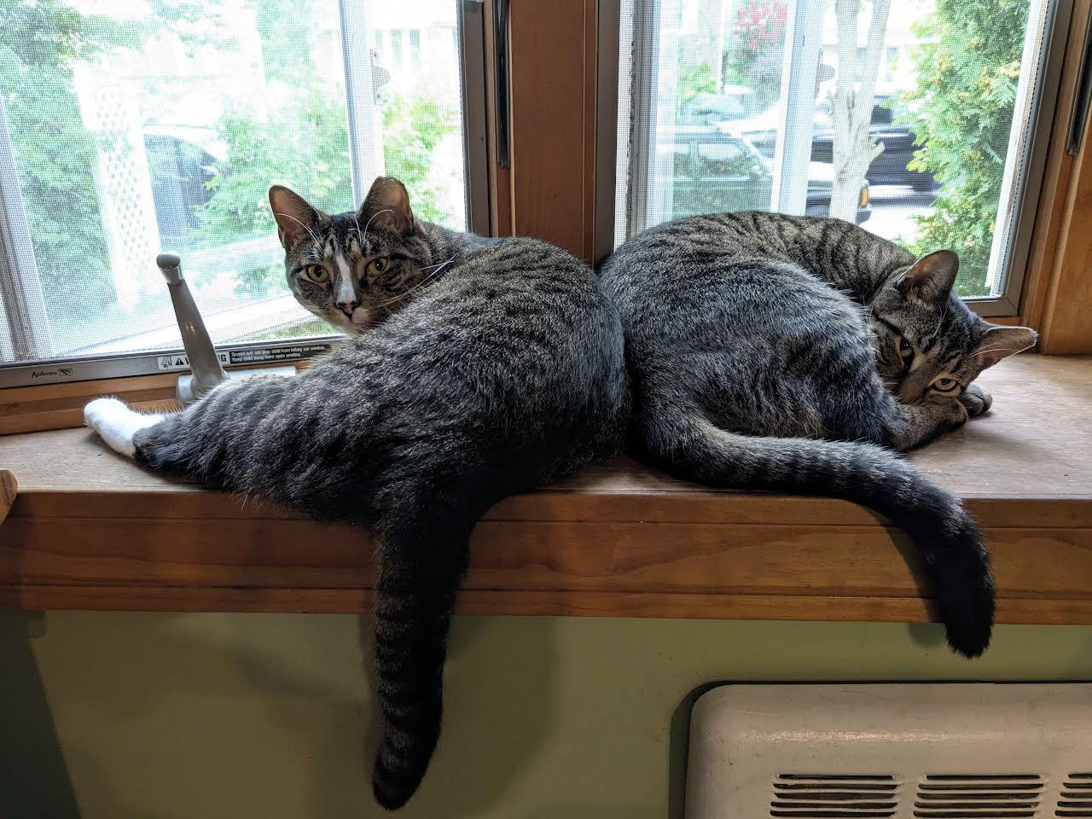
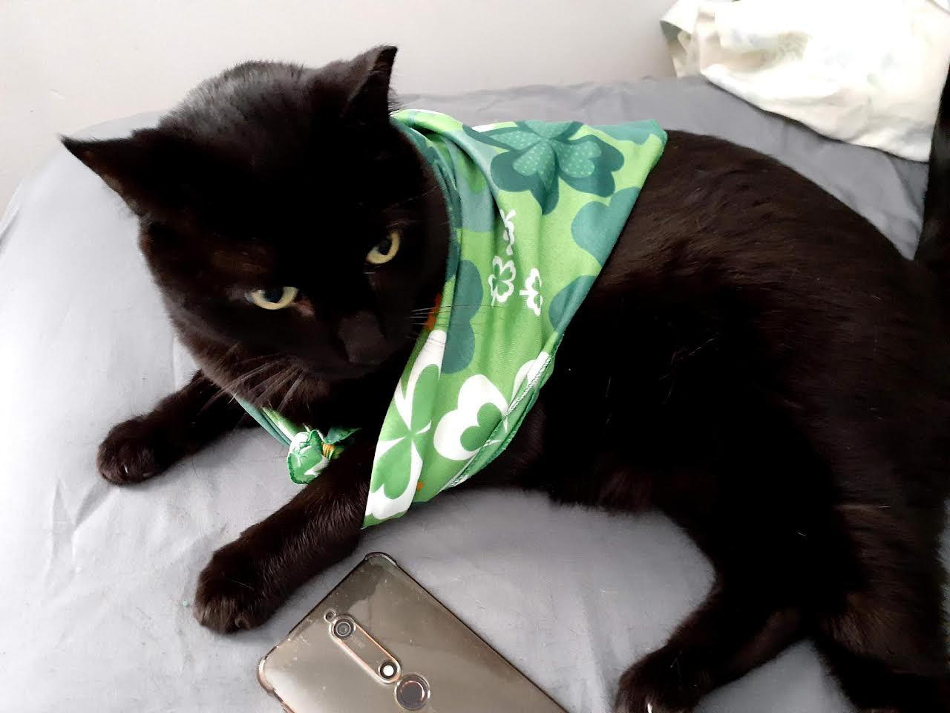
Here are my cats!

Slide 10

I cannot wait to get to know you all this year!
Are there any questions?

